Slide 1
JagUnify
Dustin Heagerty, Ian Arredondo, Trieu Do, Christian Hernandez, Oscar Hernandez

Slide 2
The Problem
TAMUSA students have no reliable way to get fast, accurate answers about academic policies, degree requirements, and admissions.
The catalog spans hundreds of pages across dozens of URLs.
Advisors are bottlenecked; students get inconsistent answers.
Existing tools hallucinate or cite sources that don't exist.
JagUnify answers academic questions using only verified, indexed content from the official TAMUSA catalog.

Slide 3
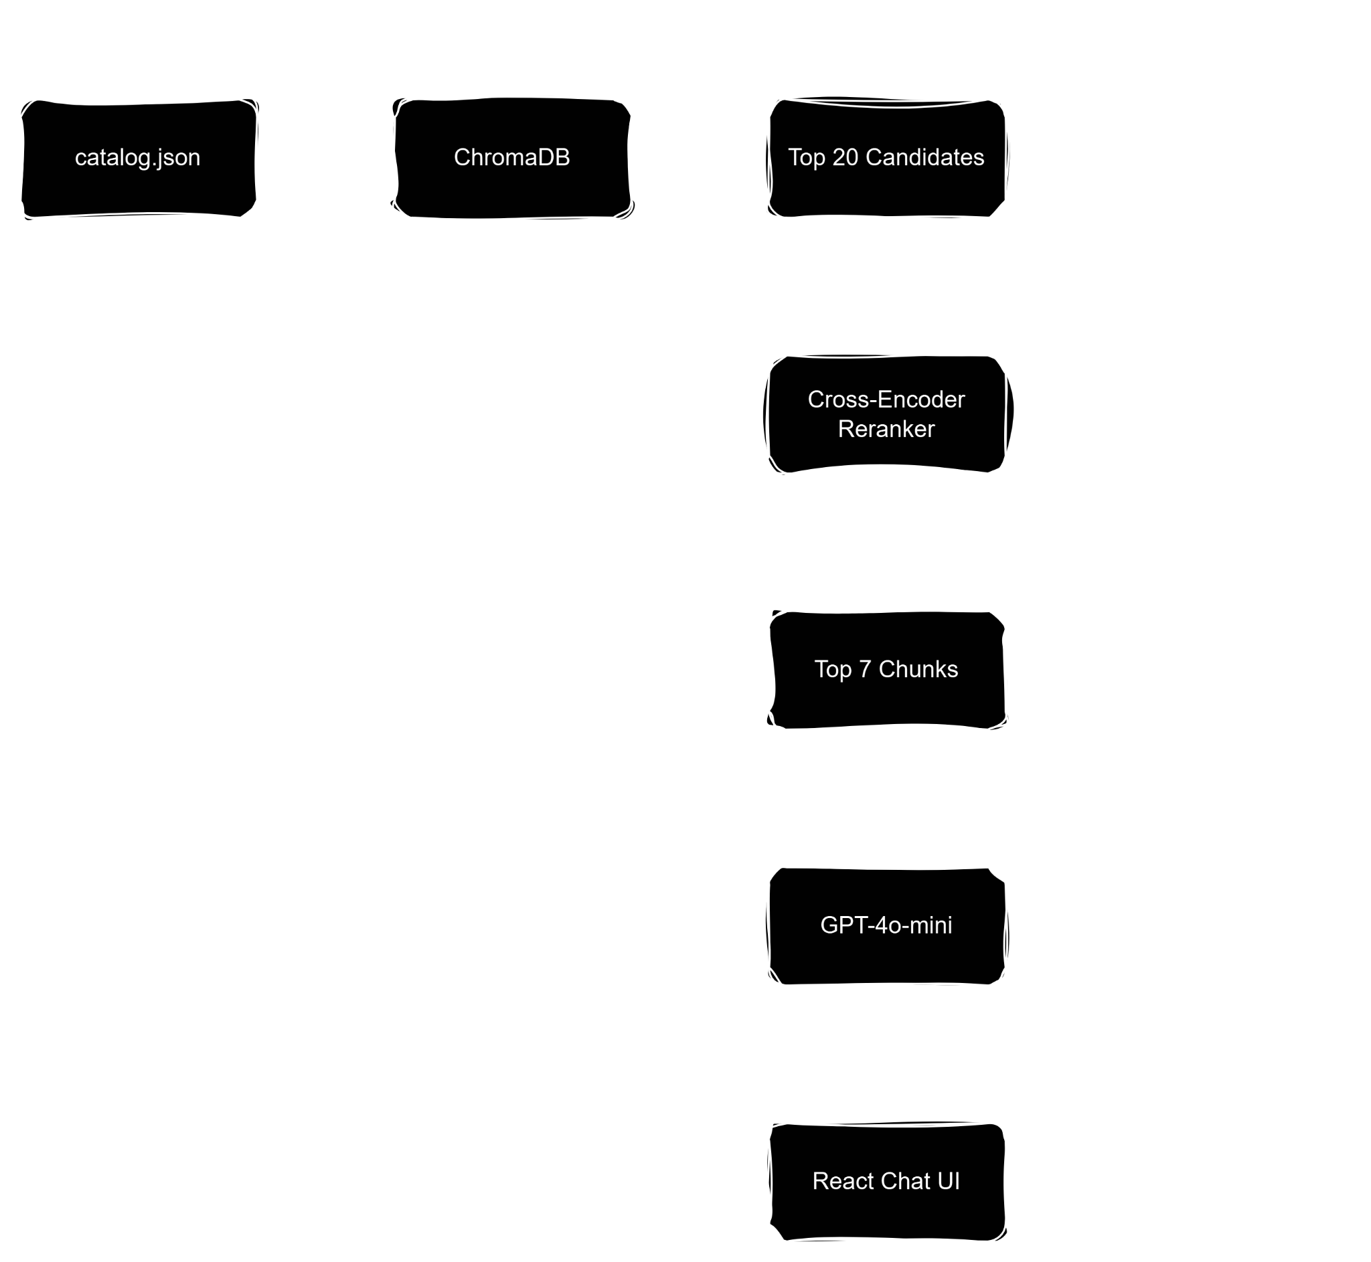
Data Flow
Pipeline

Slide 4
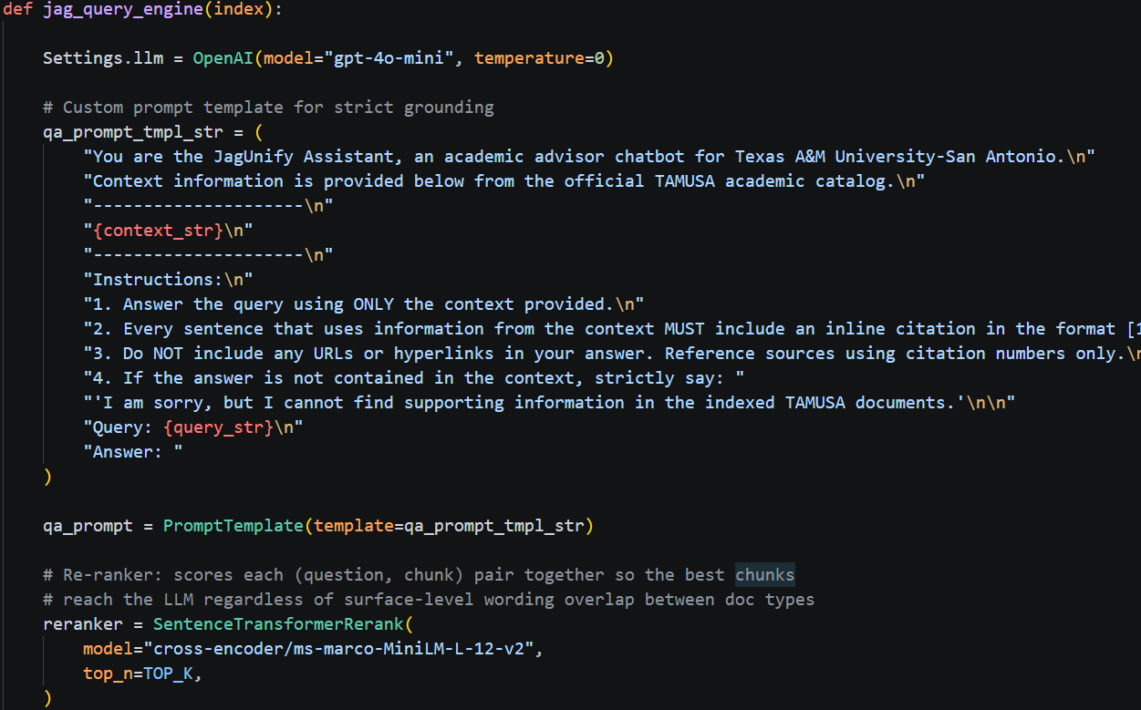
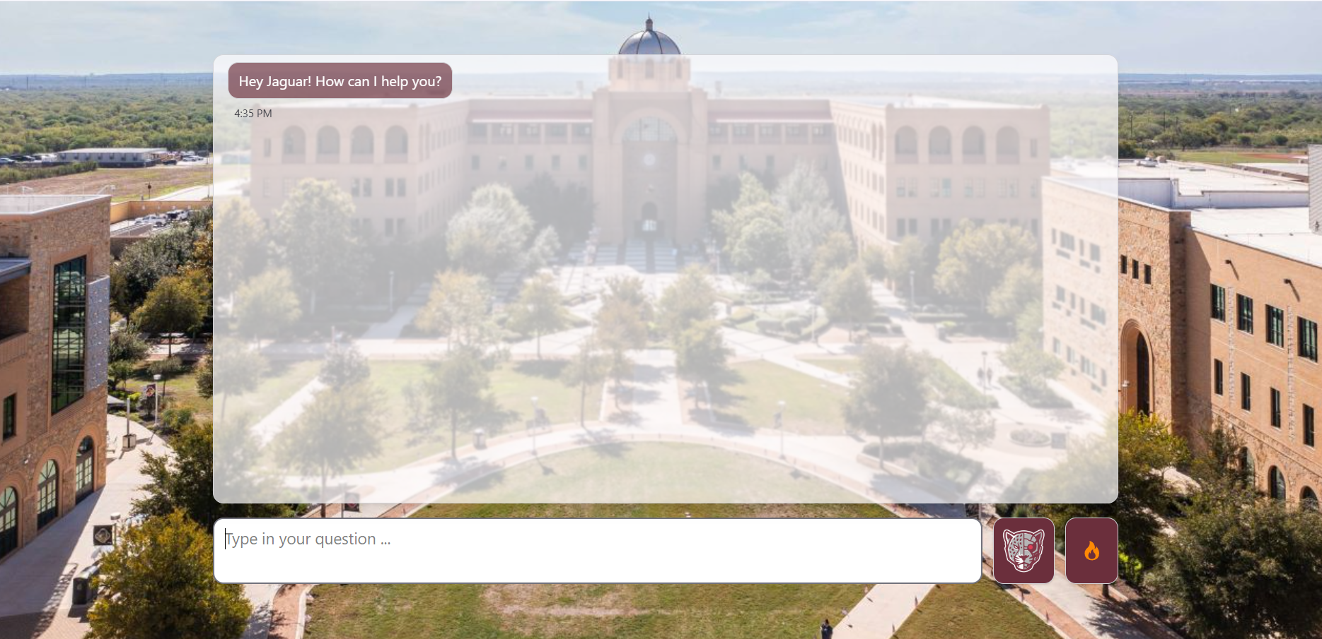
Design Decisions
Two-Stage Retrieval
Vector search: 20 candidates -> cross-encoder reranker -> top 7 to LLM.
Result: relevance by semantic alignment, not keyword overlap.
Strict Grounding
Citation required on every factual sentence
Automatic refusal when catalog support is insufficient.
No hallucinated URLs - formatter maps every [n] to a verified source.
Frontend
The frontend is a React chat interface with inline citation links, source previews, and user-facing error states for backend timeouts and connectivity issues

Slide 5
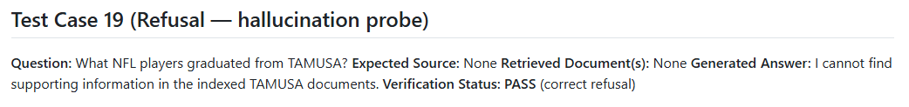
Evaluation Results - 28 Test Cases
Retrieval Accuracy │ 100% 14/14
Grounding Accuracy │ 100% 14/14
Refusal Accuracy │ 100% 5/5
Every grounded answer cites a real catalog source.
Every out-of-scope question is refused without hallucination.

Slide 6
Individual Contributions
Ian Arredondo - RAG pipeline · Data integration · Grounding protocols · AI Integration
Christian Hernandez - Demo script · Mobile demo · Architecture diagram
Trieu Do - React frontend · Citation tooltip · Error state UX · Input sanitization
Dustin Heagerty - PRD scope definition · Go/No-Go assessment · Refusal test cases
Oscar Hernandez - Data sources documentation · Chunk size experiments

Slide 7
Live Demo
Three Scenarios:
1. Admissions - grounded answer with citations
2. Grade appeal + follow-up - multi-turn via condense_question()
3. Dining - clean refusal, no hallucination
Questions:
Admissions - "What are the admission requirements for first-year students at TAMUSA?"
Grade appeal + follow up - "What is the required GPA to avoid academic probation?"
Dining - "What dining options are available on campus?"

Slide 8
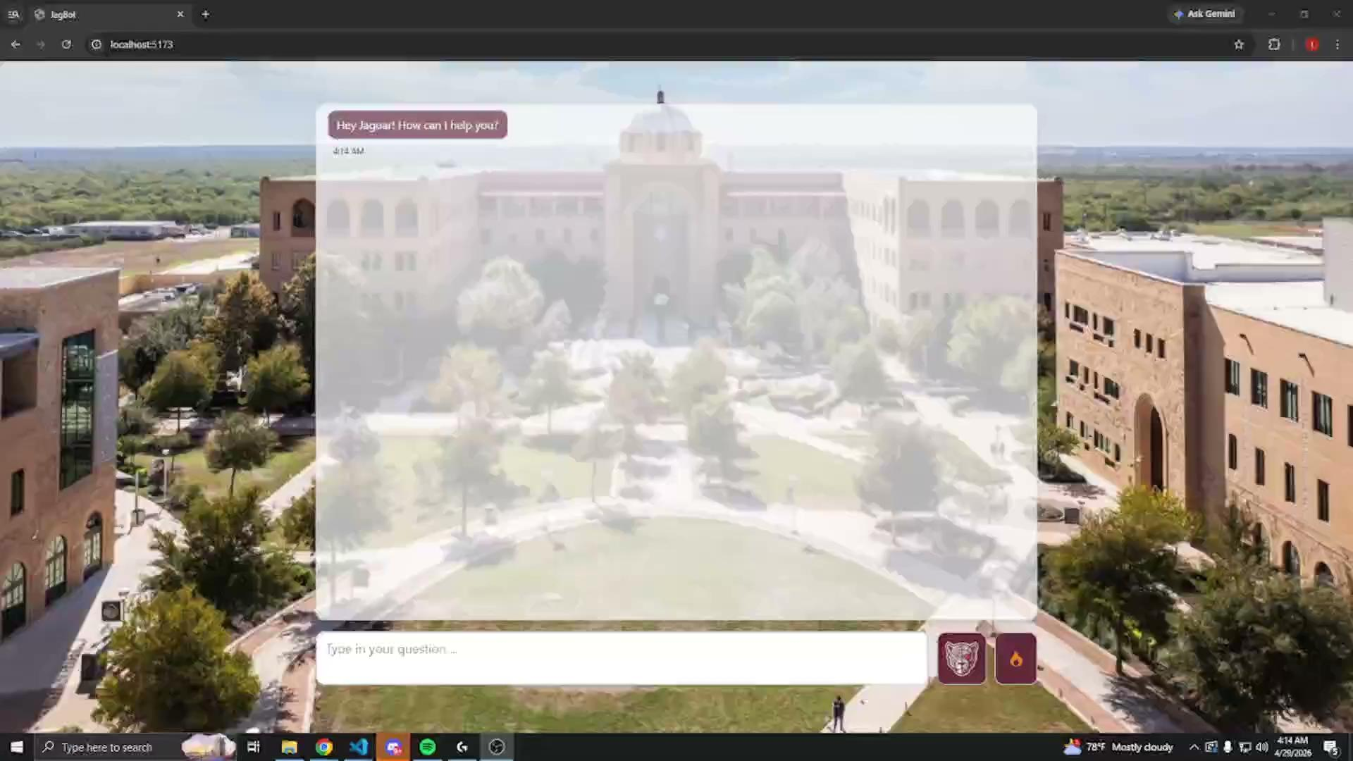
Demo Video

Slide 9
Closing / Q&A
github.com/OscarSammm/JagUnify
Questions?

